Slide 1
How to Take Care of Your Guinea Pig by Tyler mcmichen

Slide 3
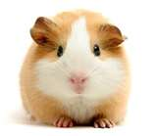
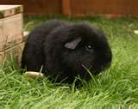
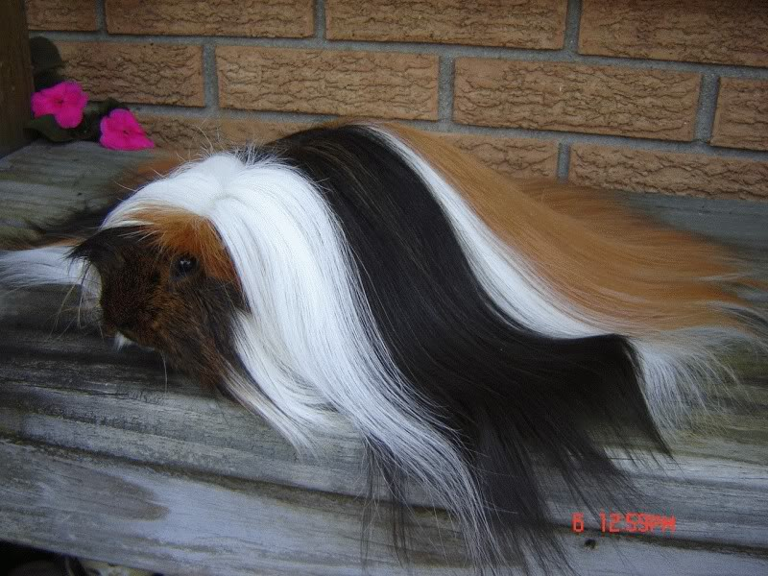
Choosing your Guinea Pig

Slide 4
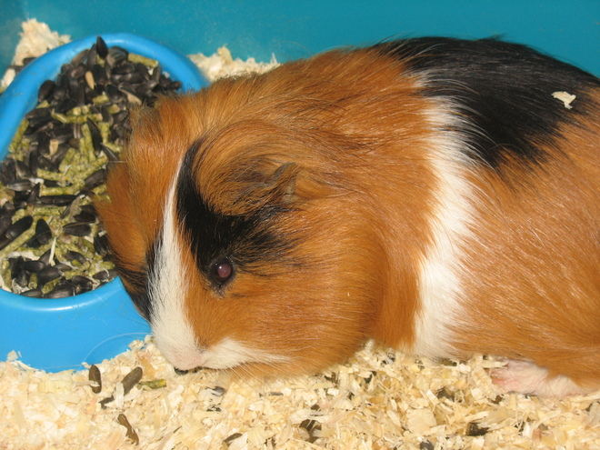
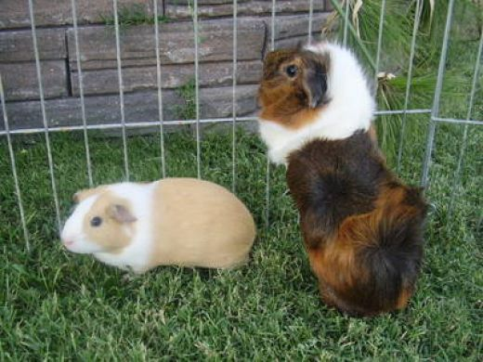
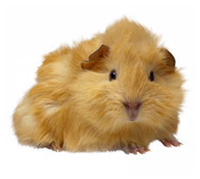
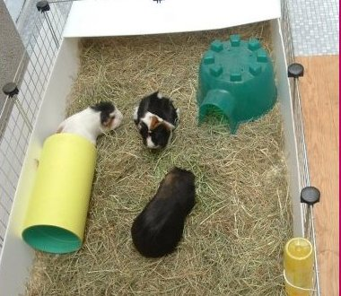
Guinea Pigs need to be taken care of.

Slide 5
Guinea Pigs are a lot of work.

Slide 6
The End

