Slide 1
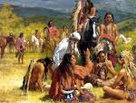
The First Americans

Slide 2
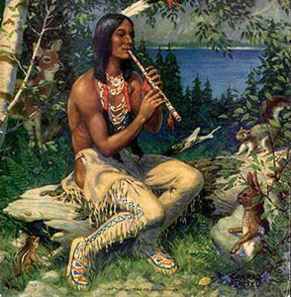
How do you think the first Americans arrived?
Brainstorm with your group

Slide 3
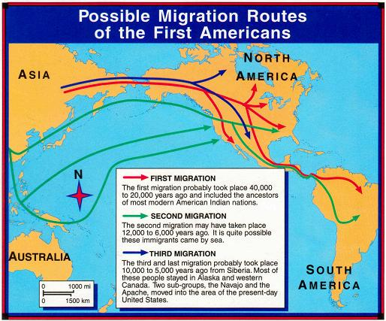
The Land Bridge Story
Beringia-the name given to the land bridge between Asia and North America
Some scientists believe that hunting groups from Asia started traveling across the Beringia land bridge

Slide 4
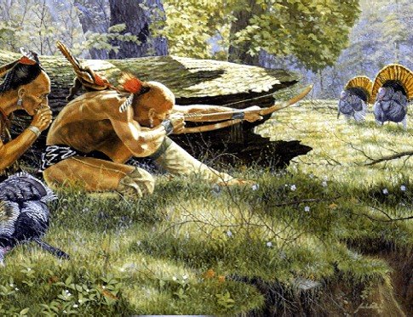
Migration
Movement of people
Probably took place very slow, with groups traveling only a few miles in a lifetime
Many believe that the people were following the animals they hunted

Slide 5
Early Americans Video
Video link for early Americans:
Pre-Columbian video: http://www.hippocampus.org/US%20History;jsessionid=8AB9B7C62C20EA5583903AF5DDBEE021

