Slide 1
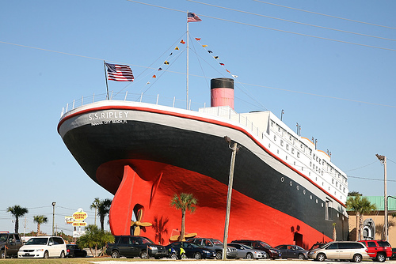
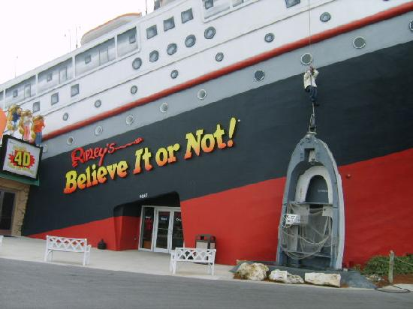
Ripley’s Believe It or Not
By: Ivey Riddle

Slide 2
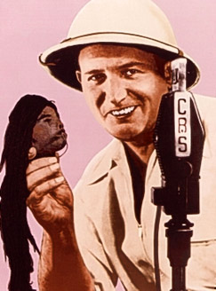
About Robert Ripley
Robert Ripley started out as a cartoonist. He was fascinated with curioddities of life. Curioddities means feats , folk , artifacts , & accounts .
By 1933 Ripley collected enough material to open Ripley’s Believe It or Not . He visited 201 countries, notching up to 464,000 miles . Today there are 31 museums in 11 countries. I have been to his museum in Panama City , FL.
There are books about his curioddities for people who can not visit his museums.
You can even get in the book too , but you have to do something weird . If you do , contact www.ripleybooks.com, or write to BION Research , Ripley Entertainment Inc., 7576 Kingspointe Parkway , 188 , Orlando , Florida , 32819 .
Now that I have told you about Robert Ripley let us look at some of the information he collected .

Slide 3
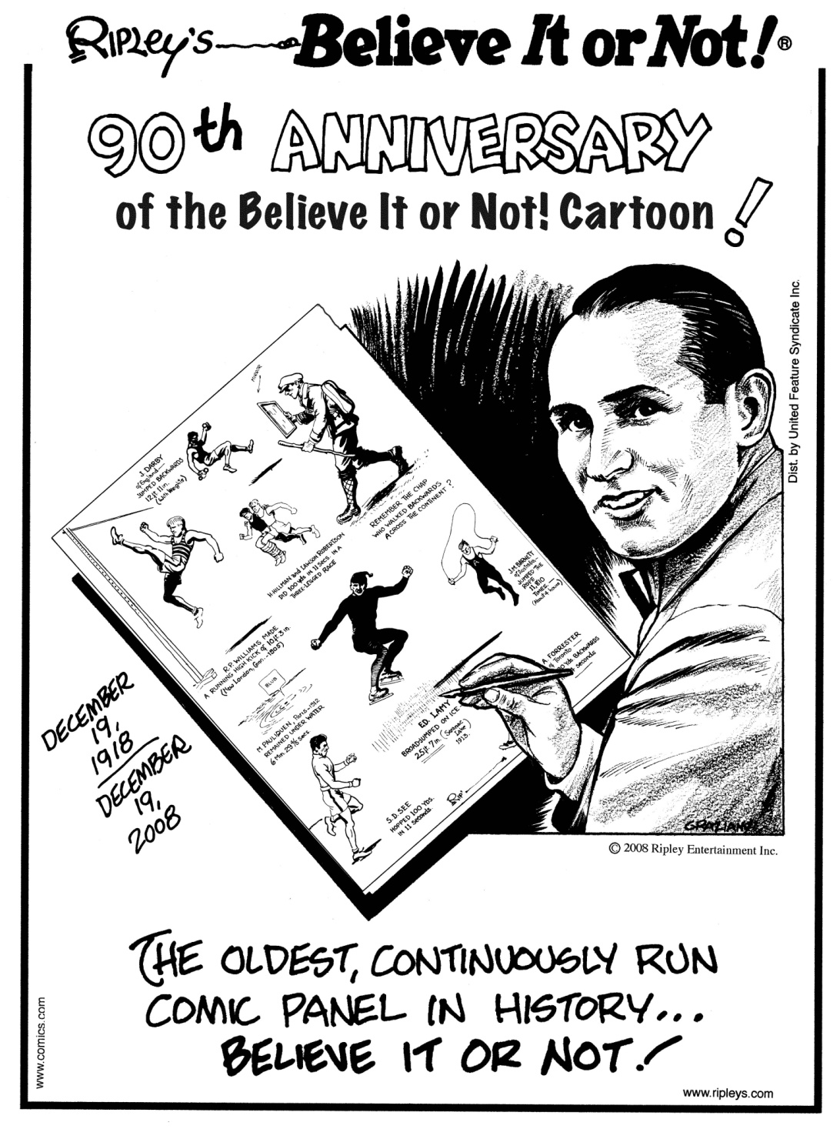
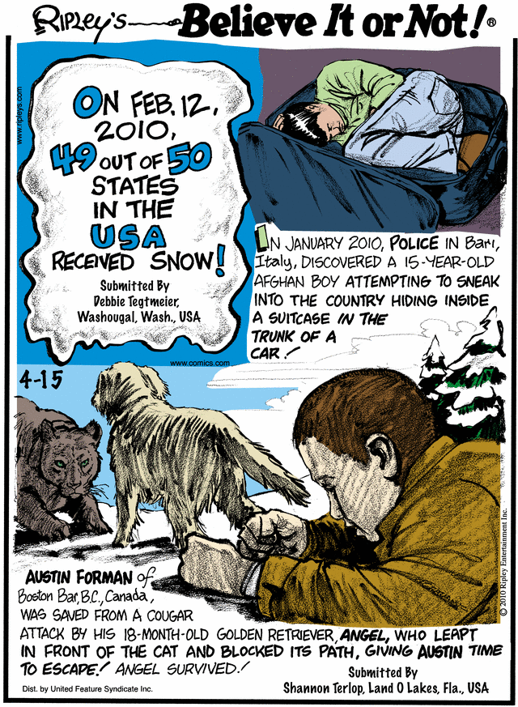

Slide 4
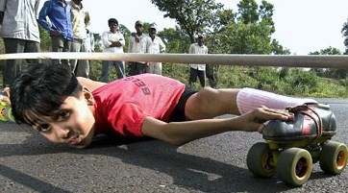
Limbo Legend
This kid doesn’t skate around cars he skates under cars! Yes , seven year old Aniket Chindak was inspired to take up limbo-skating after seeing a girl skate under a car on TV . It took 3 months for him to get in the right position. He was 8 inches from the ground.WOW!

Slide 5
Seedling Surprise
Justin Martin had a wreck and was thrown into a pasture . He suffered many broken bones, and had 4 surgeries. After his injuries healed there was still a lump in his arm, and it really hurt so he returned to the hospital. In a final operation, doctors removed a cocklebur plant, complete with a stem and bloom that had been growing in his arm.

Slide 6
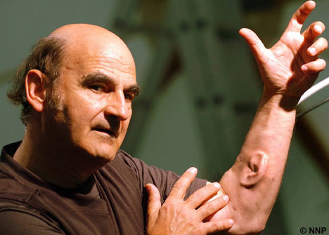
Arm Art
For Australian artist Stelios Aracdiou 2 ears aren’t enough. He has a 3rd , on his arm! He got a artificial ear implanted on his arm & plans to get a microphone to transmit what is happening on the internet. In the past he has attached a third artificial hand to one arm, and even swallowed a camera to study his stomach.

Slide 7
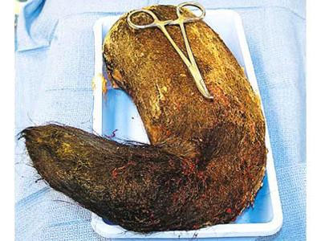
Hairball Horror
This is a big one! No, really, a teenager one day at school complained about stomach pains, vomiting, and weight loss. She was rushed to the hospital where doctors scanned her stomach and discovered it was blocked by a giant hairball. In the end she did admit she had been eating her hair for the past five years.

Slide 8
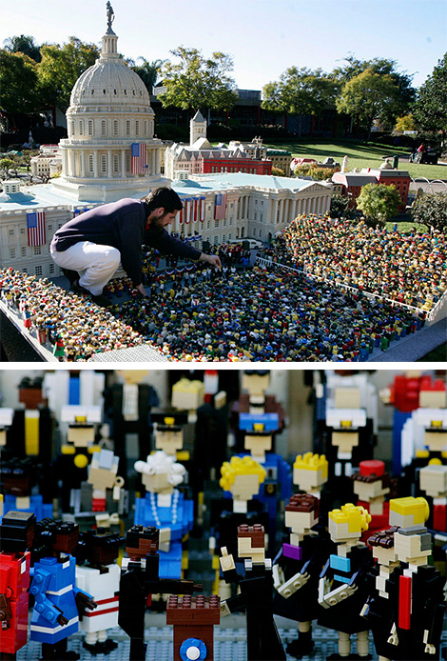
Brick Obama
I bet it took a long time for this one! This replica of Obama’s inaugural speech was made of Legos. The people were made of 30 to 40 blocks. It was made in LEGO land ,CA.

