Slide 1
Digging Deeper Into the K-5 ELA Standards
College and Career Ready Standards Implementation Team
Quarterly – Session 2
Notes:
Welcome to the second of four College and Career Ready Standards Implementation meetings.
Ask if there are any new people this time.

Slide 2
Today’s Outcomes
Participants will …
Gain a deeper understanding of the vertical alignment of grade level standards (K-5).
Gain a deeper understanding of how the key shifts support the implementation of the standards (K-5).
Clarify their understanding of what the standards look like in practice (K-5).
Notes:
Read outcomes.

Slide 3

GOAL
Strands
Notes:
Let’s begin by looking at Alabama’s COS document.
This graphic represents the conceptual framework. The banner represents the goal that all students achieve English Language Literacy in order to be college/career ready.
The standards are organized through the strands that you see in the graphic….Language, Speaking and Listening, Reading Literature, Reading Informational Text, Reading Foundations in grades K-5, and Writing.
No strand stands alone…all are necessary and depend on each other
All must be connected in classroom instruction in order for students to become college and career ready, to graduate prepared

Slide 4
Why We Need Common Core
Video Clip
  http://www.youtube.com/watch?v=dY2mRM4i6tY

Slide 5
English
Language
Literacy
Writing
Reading
Language
Speaking & Listening
Reading Informational Text
Reading Literature
Reading Informational Text
Foundational Skills (K-5)
Foundational Skills (K-5)
Notes:
It might help you to look at it like this.
There are 6 strands with √ Foundational Skills, Reading Literature and Reading Informational Text all falling under “Reading.”
Today, we will focus on √ Foundational Skills and √ Reading Informational Text. This morning we are focusing on Reading Foundational Skills.

Slide 6
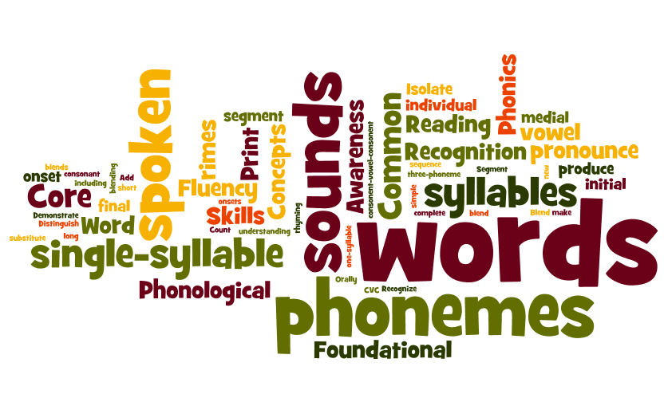
Foundational Skills
Notes:
Quick Write – when you hear “foundational skills” what words comes to your mind? Take a moment and jot them down.
Click to show the words on the screen. Ask participants if they jotted some of the same words.

Slide 7
Reading:
Foundational Skills
Subcategories:
Print Concepts
Phonological Awareness
Phonics and Word Recognition
Fluency
Notes:
What looks familiar? What’s missing? Let’s take a look at these.
Talk at your table about what each of these would look like in your classroom. Briefly share out.

Slide 8
Say Something
Handout #1
Read each statement.
Jot your thinking.
“Say Something” about the text to your partner.
Repeat the process for each statement.
Notes:
Handout #1

Slide 9
Reading:
Foundational Skills
Part A
Read the introductory paragraph on Handout #2.
Highlight important concepts covered in the paragraph regarding Foundational Skills (K-5).
Discuss the major concepts.
Complete the chart, Handout #3.
Notes:
Take out handouts 2 & 3. You will use these together. These standards are an expectation. They do not have anchor standards; however, they are not optional.
Note: The text they are to read is on the next slide.

Slide 10
Reading:
Foundational Skills
Part B
Read the Foundational Skills standards for your grades.
Underline key words that show how these standards are related.
Circle key words that show how the expectation becomes more rigorous at each grade level.
Discuss your overall impressions about the Foundational Skills Standards. What are the implications for you?
Notes:
Follow directions on the slide.
Click: Read each standard for your assigned number.
Click: As you read, underline key words that show how these standards are related.
Pause
Click: As you reread, circle key words that show how the expectation becomes more rigorous at each grade level.
Pause
Click: As you discuss your overall impressions think about what stands out to you in terms of the progression of what students need to know and be able to do.

Slide 11
Let’s Look at a Lesson Using Foundational Skills
Notes:
We’ve just spent time looking at the “what” and the “why” concerning informational text. Now let’s look at the how.

Slide 12
Standard for This Lesson
20. Know and apply grade level phonics and word analysis skills in decoding words.
b. Know spelling-sound correspondences for additional common vowel teams. RF.2.3b
Notes:
We are about to view a lesson using Reading Foundation standard #20.
√ Remember that Alabama’s COS is numbered sequentially. (20)

Slide 13
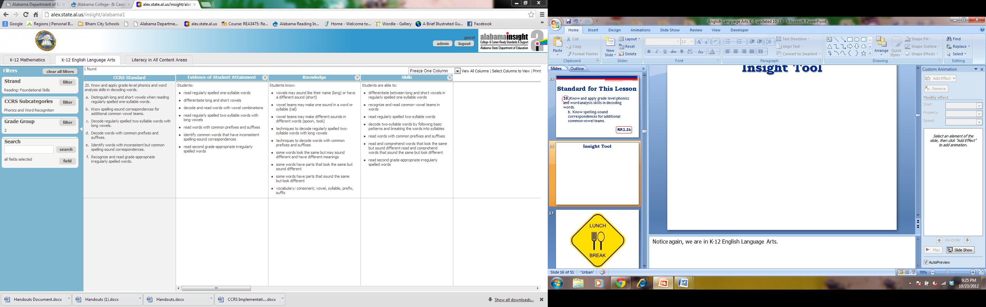
Insight Tool
What procedural skill(s) does the student need to demonstrate for attainment of this standard?
What could students do to show attainment of this standard?
What does the student need to know to aid in attainment of this standard?
Notes:
Please remember how helpful the Insight Tool is when developing your lessons.
The strand is Reading Foundations, grade 2. I can determine evidence, knowledge and skills of the lesson.
Notice again, we are in K-12 English Language Arts.

Slide 14
Lesson Objectives
Students will be able to
read and spell words with the /ou/ sound spelled ou.
Notes:
Read objective.

Slide 15
Planning for Instruction
Considerations:
Provide multiple opportunities for students to practice reading words with the new sound-symbol correspondence.
Determine what needs to be done if a student is having difficulty.
Notes:
4 planning questions
What are my outcomes?
What steps will I take to meet the outcomes?
How will I know if students are meeting the outcomes?
What will I do if a student is not meeting the outcomes?

Slide 16
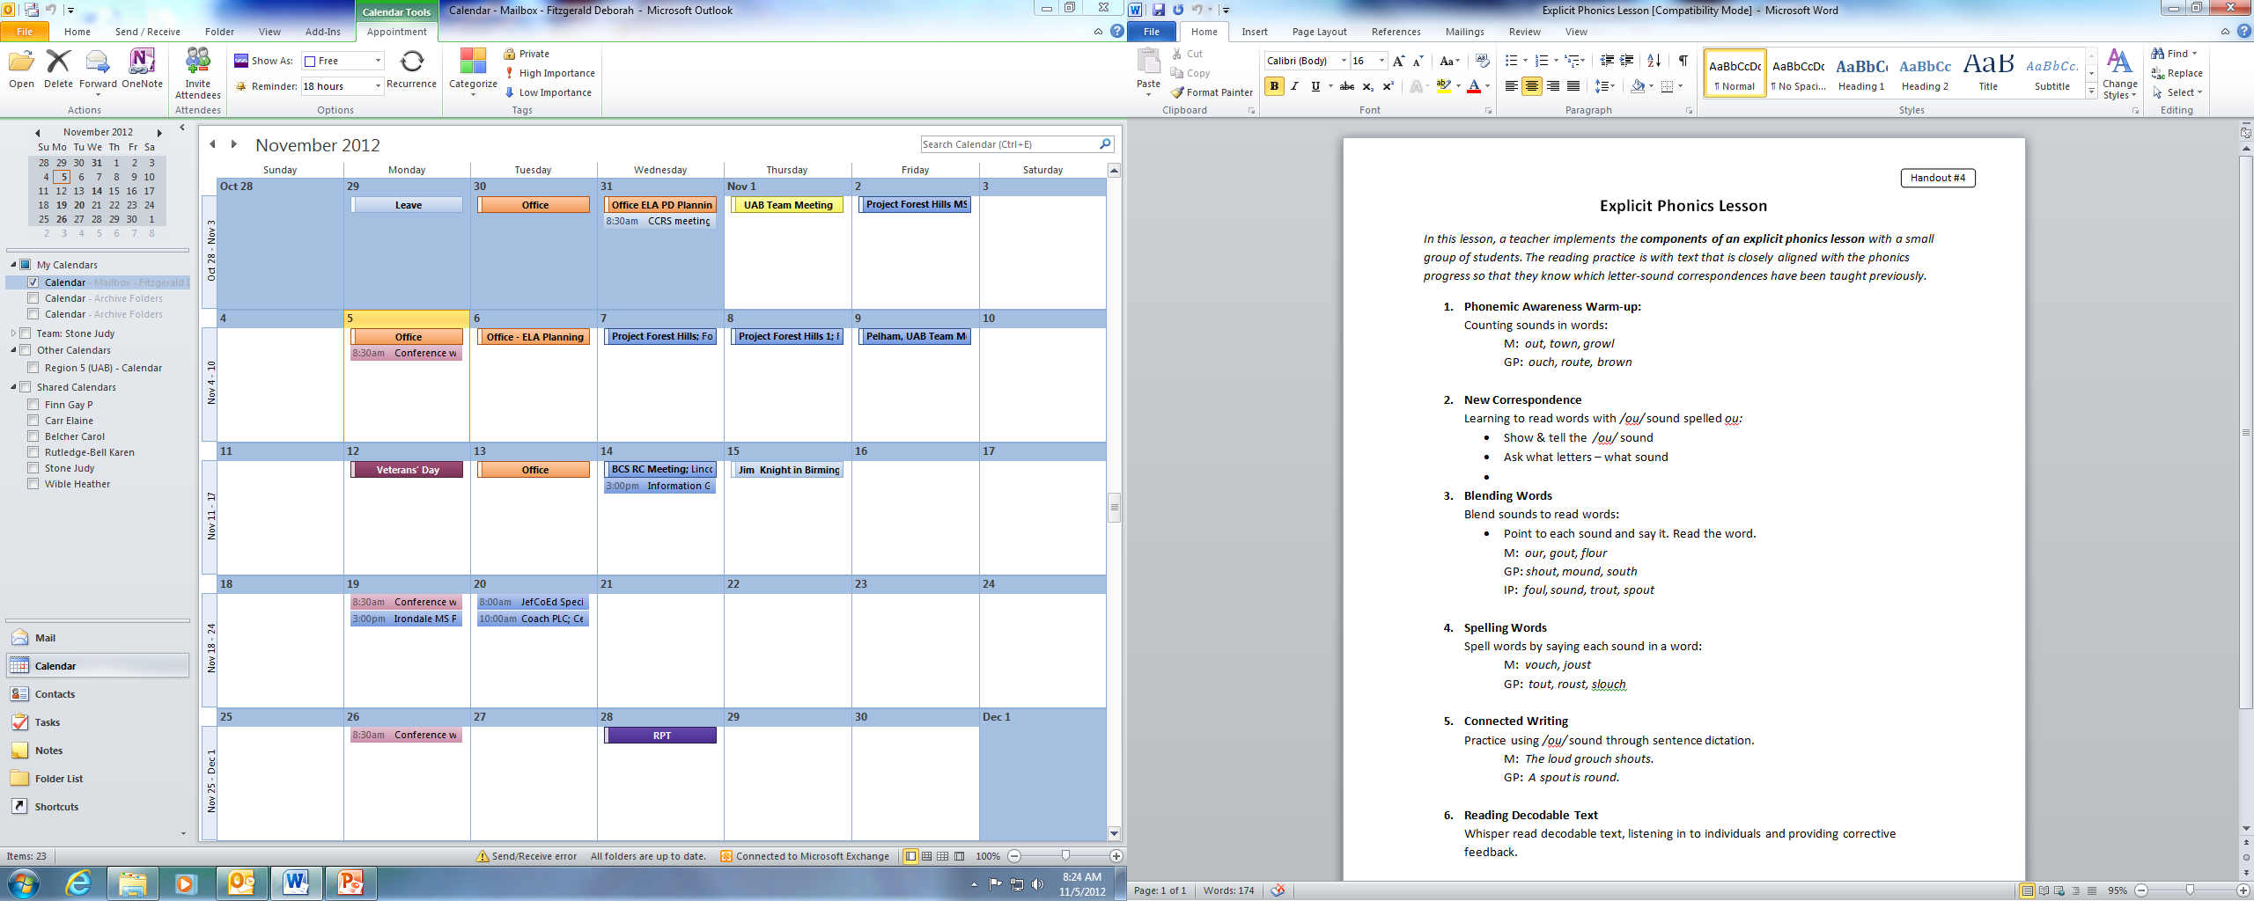
Gradual Release of Responsibility
Model = M
Guided Practice = GP
Collaborative Practice = CP
Independent Practice = IP
Notes:
The lesson you will see today is an example of an explicit phonics lesson. This lesson format should look familiar to you. It comes from the ARI Professional Development Module. You’ll notice the gradual release of responsibility.
Now let’s look at a slightly different format that will help us think through the planning of a lesson.

Slide 17
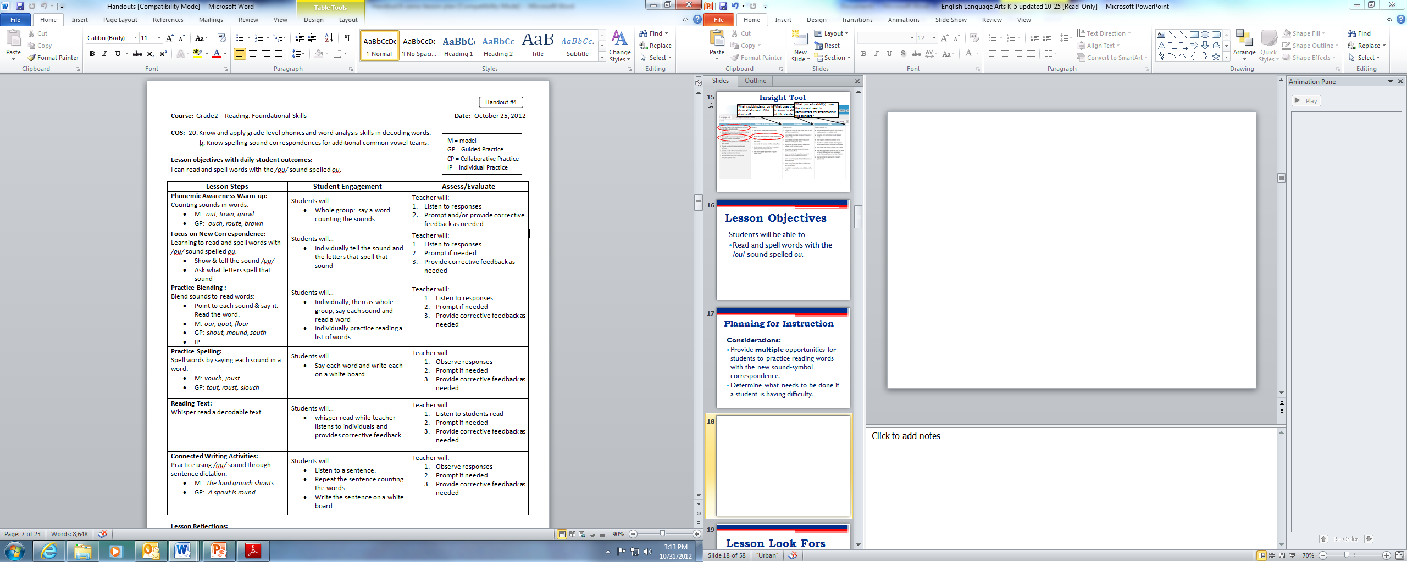
Notes:
The expectation is not that you begin writing lessons using this tool; however, this is how we recommend you think through your planning of a lesson.
Talk participants through the lesson planning tool, handout #4, making your thinking visible.

Slide 18
Lesson Look Fors
Use the lesson plan tool to look for evidence that the lesson objective is being met.
Notes:
As you are observing the lesson, you may want to circle, check or indicate when you see a part of the lesson for which we planned.
Also, as always, we will look for evidence that students have met the outcome.

Slide 19
Phonics Lesson

Slide 20
Was the Outcome Met?
Students will be able to read and spell words with the /ou/ sound.
Notes:
Discuss with your table the evidence you recorded that the outcomes were met.

Slide 21
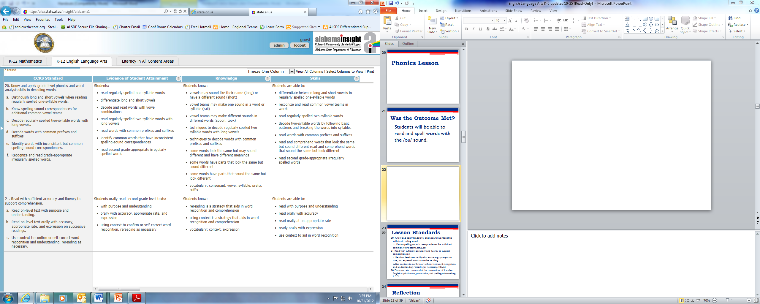
Notes:
Having just traced the standards, I’m sure you noticed some other standards that the lesson touched on.
√ Let’s look at what some “secondary” standards that were touched on during this lesson. Although they are not primary standards in this lesson, they will be primary standards at some other point. Notice that we only touched a portion of some of these.

Slide 22
Lesson Standards
20. Know and apply grade level phonics and word analysis skills in decoding words.
b. Know spelling-sound correspondences for additional common vowel teams. RF.2.3b
21. Read with sufficient accuracy and fluency to support comprehension.
b. Read on-level text orally with accuracy, appropriate rate, and expression on successive readings.
c. Use context to confirm or self-correct word recognition and understanding, rereading as necessary. RF.2.4
36. Demonstrate command of the conventions of Standard English capitalization, punctuation, and spelling when writing. L.2.2
Notes:
20 b is our primary standard. It was the focus of our lesson.
Remember, these are standards that we are going to be continuously working on.

Slide 23
BREAK
Up Next:
  Review of Text Complexity and 3 Key Shifts

Slide 24
Why Informational Text?
Go to Handout 5 from Appendix A.
Find the starred paragraphs.
Read these three paragraphs to investigate and note the importance of informational text in the standards.
Write your “aha’s and questions” on Handout #6.
Think about and discuss examples you could use throughout the day, across the curriculum.
Jot examples on the chart.
Notes:
Follow the directions on the slide. Share out a few key aha’s.
Ensure participants understand that the literacy standards for K-5 science and social studies are embedded in the Reading Informational Text standards.

Slide 25
Why We Need Common Core
http://www.youtube.com/watch?v=yll0fJrUAWE

Slide 26
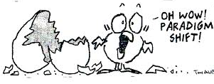
Three Key Shifts in ELA/Literacy
Building knowledge through content-rich
nonfiction and informational texts.
2. Reading, writing and speaking grounded in evidence from text, both literary and informational
3. Regular practice with complex text and its academic language
Notes:
Quick review of QM #1:
Let’s quickly remind ourselves of what the focus of our last meeting was. Last time we discussed the 3 key shifts. Be sure you have poster of 3 shifts up. You will refer to it throughout the day.
You’ll notice that the first shift focuses on informational text.
Across the state there was a lot of conversation at the last meeting about the difference between “content-rich nonfiction” and “informational text.”

Slide 27
Informational Text
subgenres
expository
text
functional text
literary nonfiction
argument
Notes:
Informational text is a broad category that includes the subgenres of exposition, argument, and functional text. This includes books, magazines, handouts, brochures, CD-ROMS, journal articles, technical texts like directions, forms, graphs, charts, and maps, internet resources,
The Common Core definition of “informational text” is broad, including (but not limited to) biographies, memoir, technical texts, graphs and charts, speeches, essays, opinion pieces, and digital sources such as blogs.
Text designed to convey factual information, rather than tell or advance a narrative. Informational text may employ techniques such as lists, comparing/contrasting, or demonstrating cause/effect, and may be accompanied by graphs or charts. Most textbooks consist of primarily informational text that gives factual information on a specific topic or event.
Designed primarily to explain, argue or describe rather than to entertain.
Purpose:
To acquire information
Satisfy curiosity
Understand our world more fully
Understand new concepts and expand vocabulary
Make connections to our lives and learning
Write good nonfiction
Have fun

Slide 28
Content-Rich Nonfiction
IS . . .
informational text that gives factual information on a specific topic or event.
designed primarily to explain, argue or describe rather than to entertain.
Notes:
See handout #7
I have to choose wisely what I’m going to teach. Mindful about the text that I choose.
Content-rich is the adjective that is important in this phrase.
It’s not new and different; it is the intentionality with which you choose text.

Slide 29
A Balance of Text K-5
Informational Text
Literature
Short Stories
Myths
Legends
Core Programs
Poetry
Science/SS
Drama
Notes:
We also learned last time that one of the reasons informational text is a shift is because the CCRS call for a “balance” of literature and informational text at every grade K-5.

Slide 30
A Balance of Text K-5
Informational Text
Literature
Biographies, History, Social Studies, Science, the arts, directions, forms, graphs, charts, maps, digital sources, etc.
Short Stories
Myths
Legends
Poetry
Drama
Notes:
We also learned last time that one of the reasons information text is a shift is because the CCRS call for a “balance” of literature and informational text at every grade K-5.
End 10:45

Slide 31

Tracing the Standards for
Reading Informational Text
Number off 1-9.
Your number represents the standard you will trace.
Notes:
So, let’s begin!
Number off at your table 1-9
Your number represents the standard that you will trace. So if you are number 1, you will trace Grade Level Standard number 1 from K-5 .
(we will not trace standard 10 at this time)

Slide 32
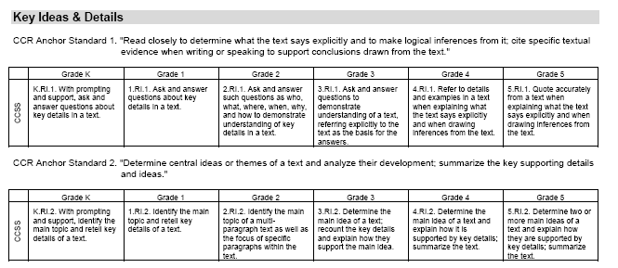
Tracing the Standards for
Reading Informational Text
CCRS Reading Informational Text Standards K- 5
Notes:
Handout#7: This is what we will use to trace the standards today.
This document is very similar to the common core document in its layout.
The difference is this document includes √ the corresponding anchor standards and √ shows all grades levels, K-5.

Slide 33
Let’s Look at a Lesson Using Informational Text
Notes:
We’ve just spent time looking at the “what” and the “why” concerning informational text. Now let’s look at the how.

Slide 34
Classroom Structure
Third grade class during the reading block
Thirty minute small group lesson
Seventeen students in the class
  Seven students are at the small group table
    Mixture of middle to high level students
    Two students in small group are identified as special needs
  Ten students are working on activities from the weekly story and taking the selection test on the computer
Notes:
Set up for lesson-quickly. Review slide.
Tell participants that they will hear noise and movement from students who are outside the small group.

Slide 35
Standard for This Lesson
19. By the end of the year, read and comprehend informational texts, including history/social studies, science and technical texts, at the high end of the grades 2-3 text complexity band independently and proficiently. RI.3.10
Notes:
√ Remember that Alabama’s COS is numbered sequentially. (19)
√ The CCR standard number is noted at the end of the standard. Reading Informational Text Third Grade, #10
#10 always deals with text complexity in the reading standards.
Read the standard. How many opportunities across your day would you have an opportunity to do this? Allow time for responses. So it is very important that you take this information back to your other content area teachers.
The text we use during this lesson comes from SF’s Sleuth. Show a copy of Sleuth. What text do you have available to you that you could use for this same purpose?

Slide 36
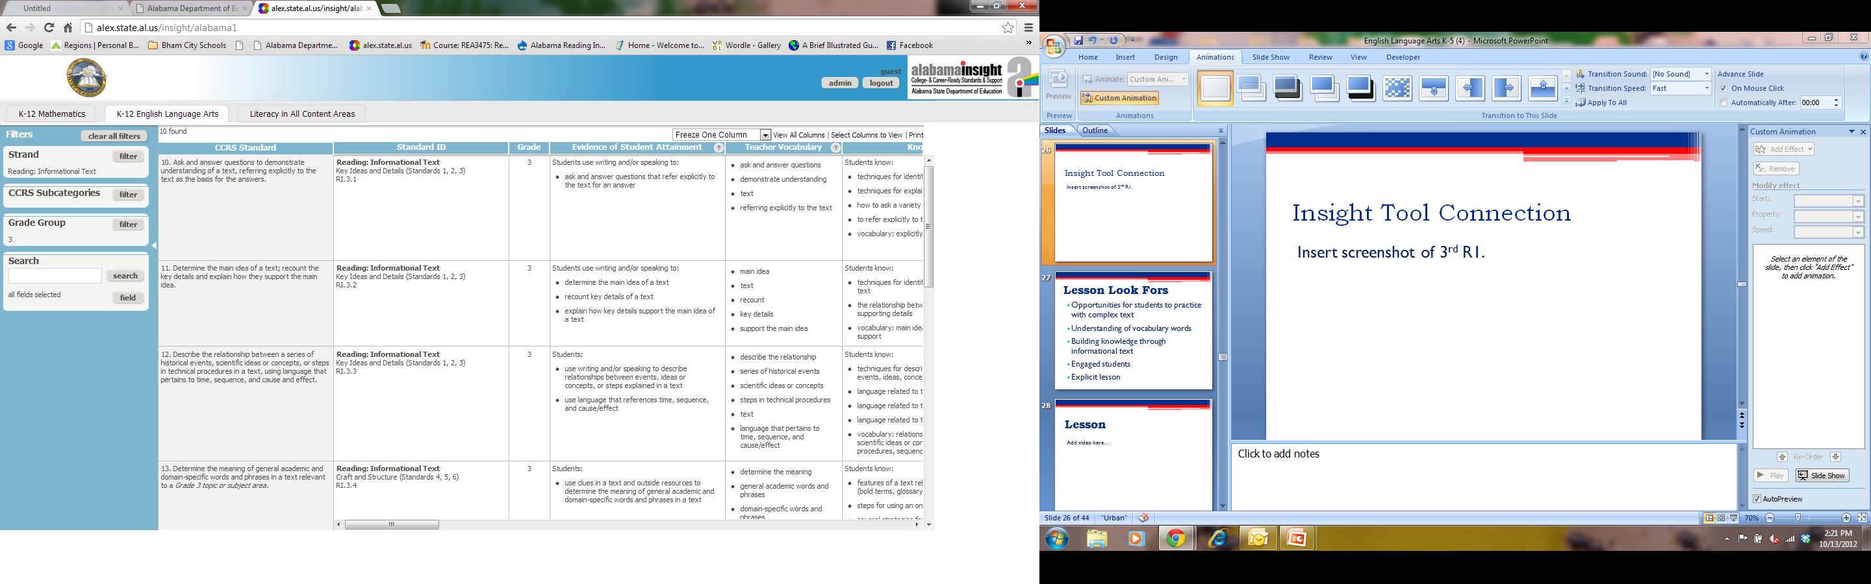
Insight Tool Connection
Insert screenshot of 3rd R1.
Notes:
PUT IN WHOLE NEW SLIDE
√ You can easily find the standards for your lesson using the Insight Tool. Notice we’re in K-12 English Language Arts.
√ We have filtered for Reading: Informational Text and √ 3rd grade.
√ You’ll recognize the 1st standard listed on the previous slide is listed right here.

Slide 37
Planning for the Lesson
Considerations:
Provide many opportunities for students to practice with complex text
Strong focus on academic language by using pictures, sentences, and examples/non-examples
Provide opportunities for students to answer questions by using details/evidence from the text
Notes:
As we planned, these are some of the things we considered based on the shifts.

Slide 38
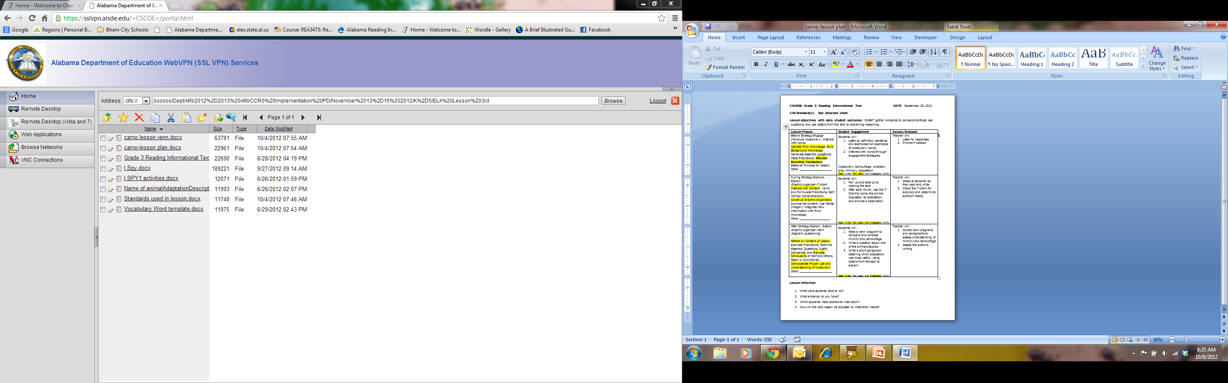
www.alex.state.al.us/isp
Notes:
The lesson plan format we are using is a tool from the Instructional Strategies Project. It is not about the tool; however, the tool helps us as we plan purposefully.
√ If you are interested in learning more about the Instructional Strategies Project, you can go to the website to learn more.
Walk participants through the tool.

Slide 39
Lesson Look Fors
Use the ISP tool to look for evidence that the lesson objective is being met.
Notes:
Handout # 9

Slide 40
Informational Text Video
Video Clip

Slide 41
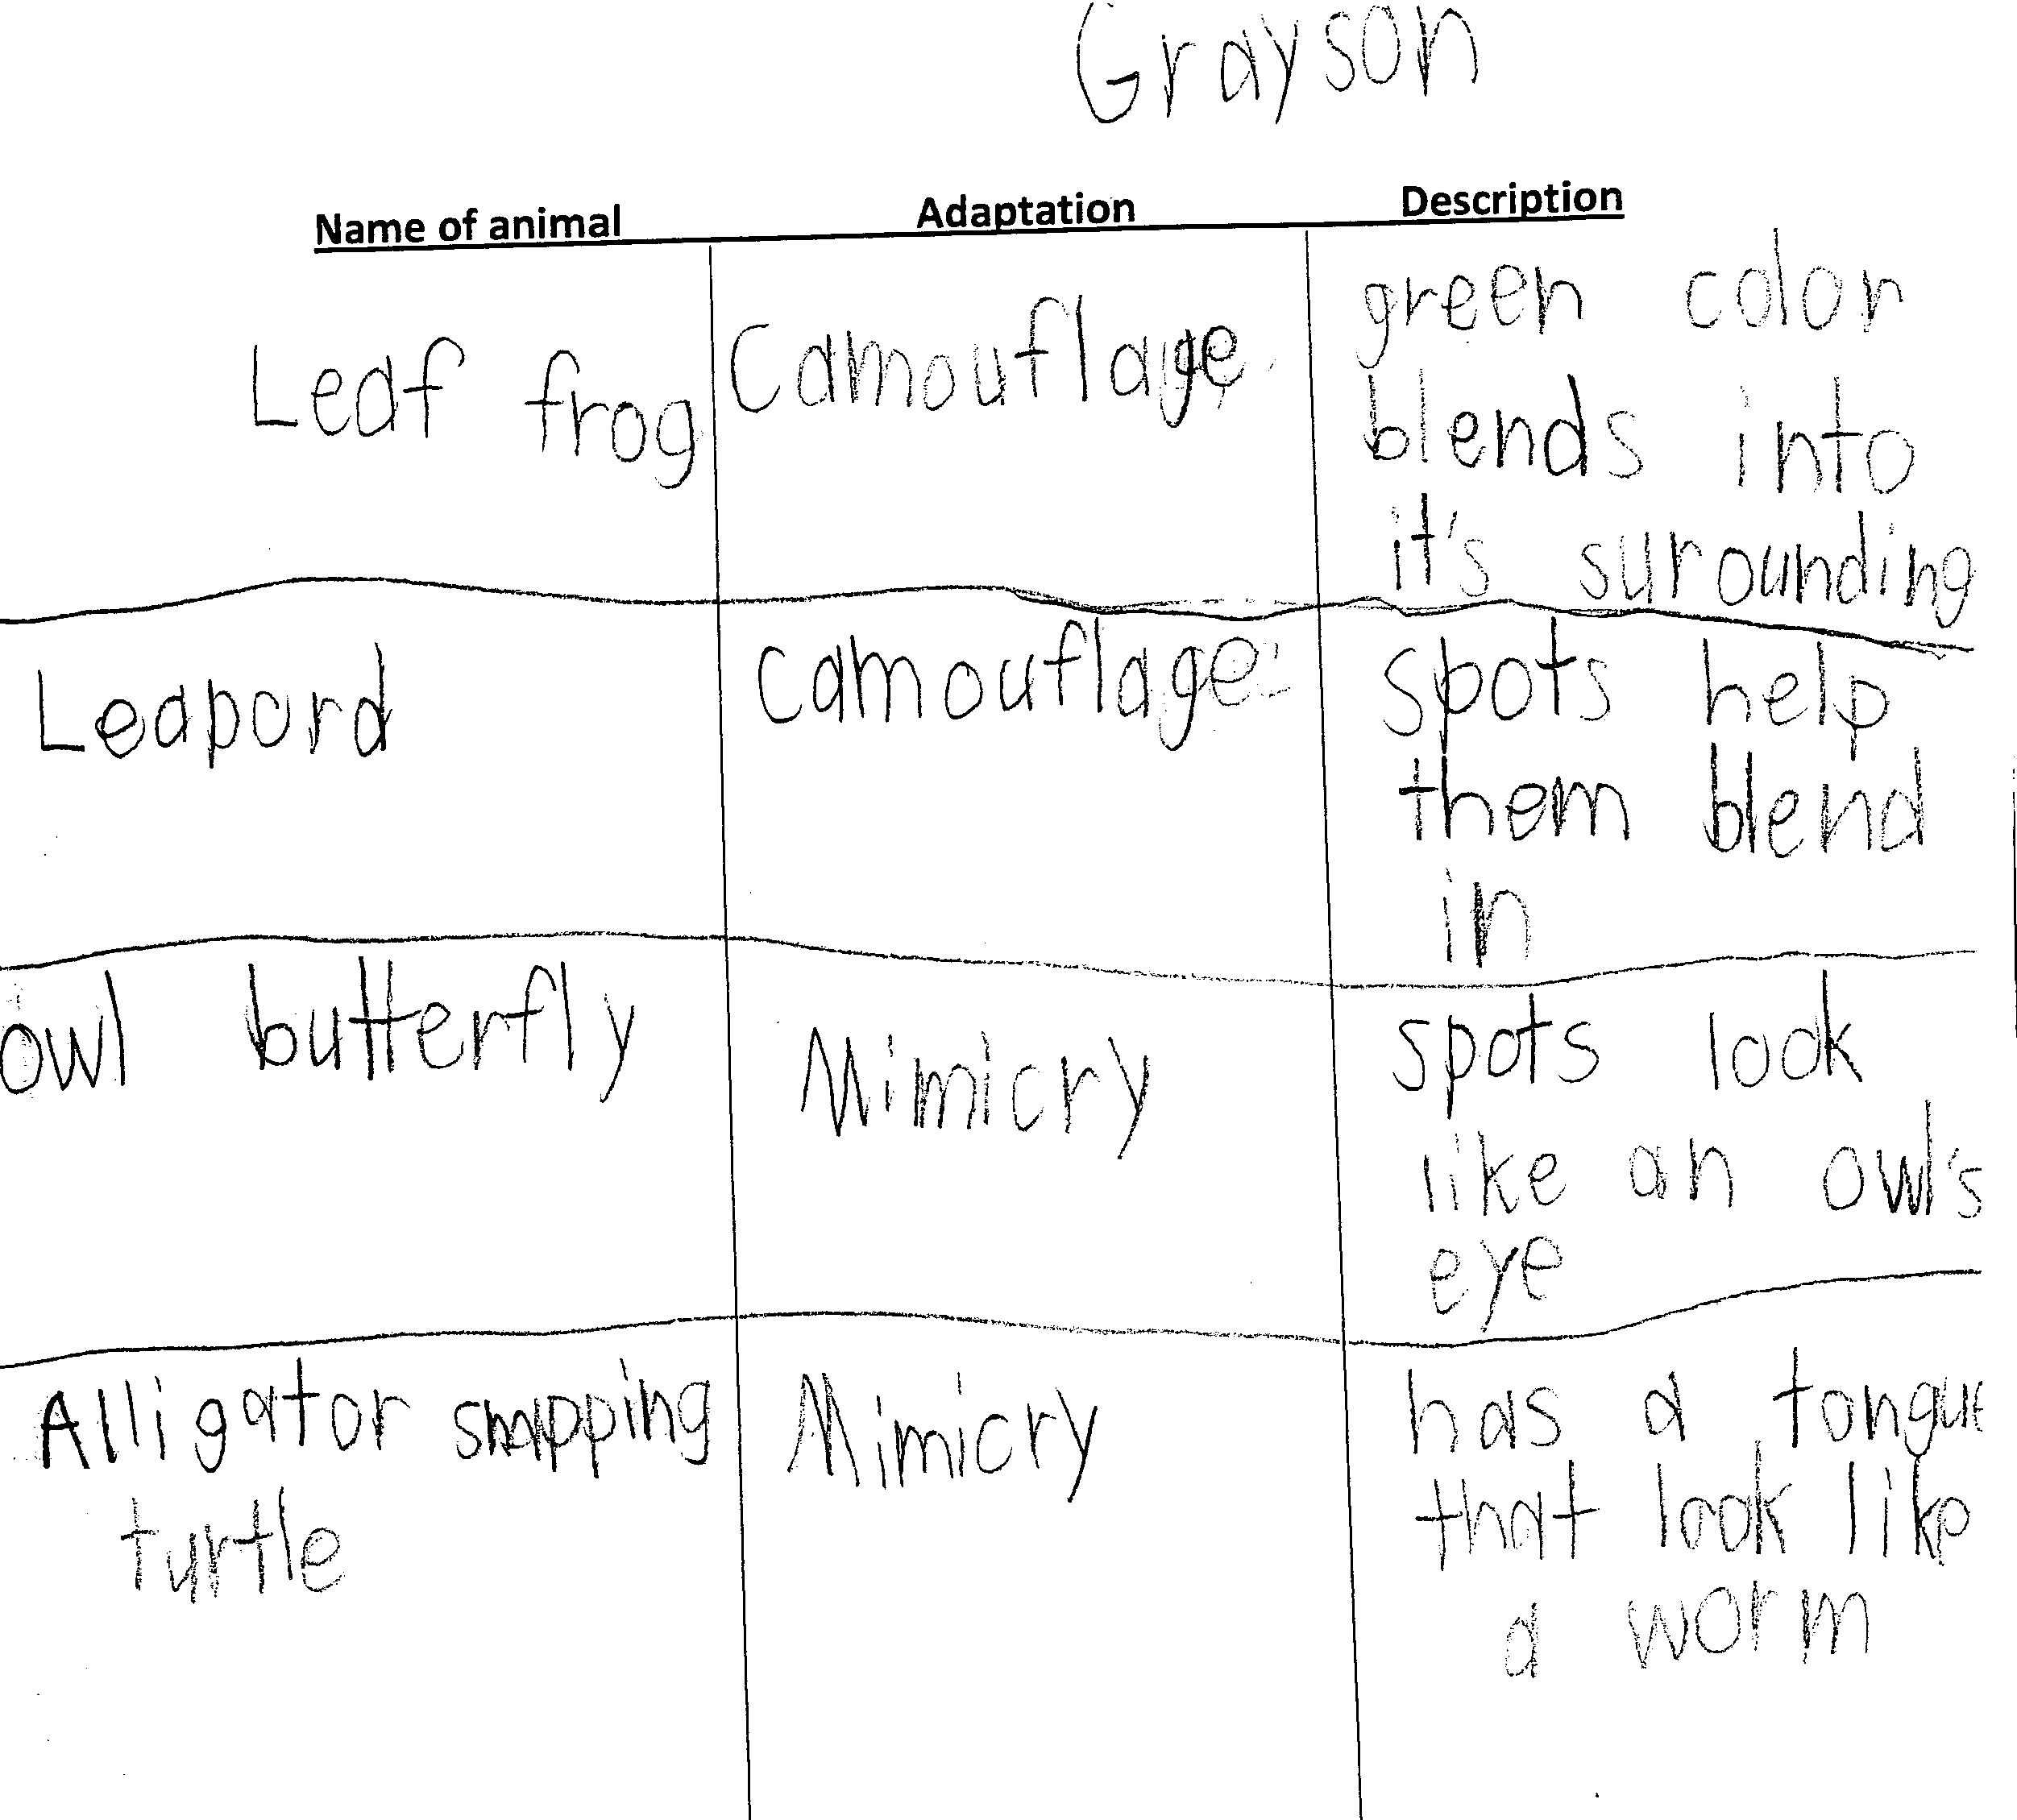
Evidence of using details from the text to explain reasoning:
Notes:
This is the lesson reflection #2 question at the bottom of the lesson plan.
Teacher modeled first row
Teacher and students completed second row together
Students completed third row with a partner
Students completed fourth row independently

Slide 42
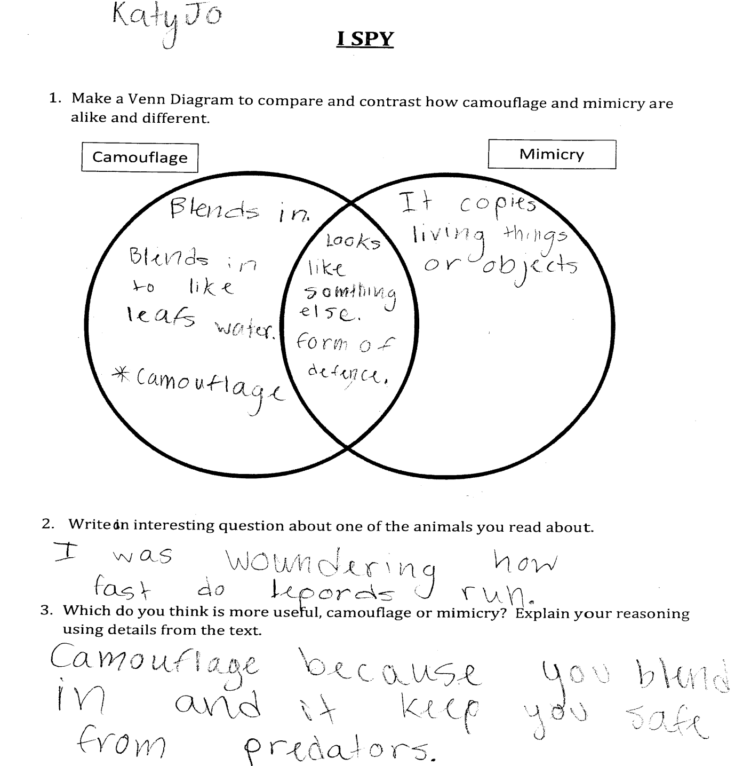
Evidence of using details from the text to explain reasoning:
Notes:
Teacher and students completed Venn Diagram and question 2 together. Students worked on question 3 without teacher help to see if they could use details from the text to explain reasoning successfully.

Slide 43
Were the Outcomes Met?
Students will be able to do the following:
gather evidence to compare/contrast
ask questions
use details from the text to explain reasoning.
Notes:
Discuss with your table the evidence you recorded that the outcomes were met.

Slide 44
Lesson Standards
10. Ask and answer questions to demonstrate understanding of a text, referring explicitly to text as a basis for the answers. RI.3.1
13. Determine the meaning of general academic and domain specific words and phrases in a text relevant to Grade 3 topic or subject area. RI.3.4
16. Use information gained from illustrations and the words in a text to demonstrate understanding of the text. RI.3.7
19. By the end of the year, read and comprehend informational texts, including history/social studies, science and technical texts, at the high end of the grades 2-3 text complexity band independently and proficiently. RI.3.10
Notes:
In previous years, you may have had 1 or 2 standards that applied to a particular lesson. This lesson, however, addresses seven standards. This slide shows the 4 standards used for Reading Informational Text.
Give participants time to review standards and talk at tables.

Slide 45
Lesson Standards
31. Engage effectively in a range of collaborative discussions with diverse partners on grade 3 topics and texts building on others ideas and expressing their own clearly. SL.3.1
22. Write opinion pieces on topics or texts, supporting a point of view with reasons. W.3.1
37. Demonstrate command of the conventions of Standard English grammar and usage when writing or speaking. L.3.1
Notes:
You’ll notice there are 3 more standards included in this lesson – 1 standard for speaking and listening, 1 standard for writing, and 1 language standard.
Our goal is teaching informational text, but the speaking & listening, writing & language are the how.
Table talk:
What does this mean for the teachers at your school?

Slide 46
Classroom Snapshots
When visiting a K–5 classroom,
You would see . . .
Time spent with informational texts.
A classroom filled with books on topics about insects, weather, energy, reptiles, the Civil War, geography, sports, and other topics that interest elementary grade children.
The use of thematically-paired story and informational texts or several informational texts grouped in a thematic unit.
Graphic organizers related to informational text and topics (e.g., K–W–L charts, Venn Diagrams for comparing and contrasting, and semantic maps).
Explicit comprehension strategy instruction.
Explicit vocabulary instruction.
Writing to read and reading to write activities about informational topics.
Notes:
These next few slides are examples of what you would eventually hope to see in K-5 classrooms when it comes to Informational text.

Slide 47
Classroom Snapshots
When visiting a K–5 classroom,
You would see . . .
Teachers and students using a core set of questions that they ask each time they encounter informational text (e.g., questions could be generic or topic-specific to guide student thinking and help them make sense of what they are reading).
A classroom configured to enable students to read, write, and talk collaboratively with partners about informational text and topics.
Teachers using ―precision partnering (e.g., student partner discussions with a designated first speaker, use of sentence starters, accountable listening, and teacher monitoring).
Task-based accountability is built in for every lesson task/activity—there is clear accountability with every student doing every task (e.g., students all required to say, write, and/or do something as an ―evidence check of engagement).
Teachers using engagement to structure discussions (e.g., responding of all students, everyone does everything—no bystanders) versus structuring discussions using traditional hand-raising (i.e., teacher poses a questions and students raise their hands to respond).

Slide 48
Classroom Snapshots
When visiting a K–5 classroom,
You would hear. . .
Language! Talk! Instructional conversations! (Beck & McKeown, 2001; 2007a; Palinscasar & Duke, 2004; Saunders & Goldenberg, 1999; Goldenberg, 1992/1993). Teacher and students talk about informational text and topics.
Questions! Teacher and student-initiated questions about the informational text.
Vocabulary! Teachers and students using content vocabulary (e.g., habitat and molt) from or about the informational text.
Academic Language! Teachers and students using text-related academic language (e.g., table of contents, index, informational book, and retell) from or about the informational text.
Teacher-facilitated read-alouds and text-based discussions (Santoro et al., 2008).
Students retelling what they learned from an informational text with a partner.

Slide 49

Reflection
What are the implications for you/your work based on your learning about foundational skills AND informational text?
Notes:
Ask participants to take out their note taking tool and answer question….about informational text.

