Slide 1
Passport Project
By: Aubrey Culver

Slide 2
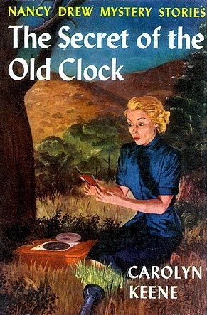
Title and Author
Title: Nancy Drew Secret of the Old Clock
Author: Carolyn Keene
She has written other Nancy Drew books.

Slide 3
Genre
Mystery
The genre is mystery because Nancy Drew is a detective and likes to solve mysteries.

Slide 4
Settings
River Hights
Mr. Drew’s office
Thopham House and Lake House
Abby Rowen’s House
Allison and Grace’s House
William and Fred’s House
Edna , Mary Turner , and little Judy’s House
Masoinville

Slide 5
Main Characters
Nancy Drew- is the detective that solves the mystery
Mr. Drew- Nancy Drew’s dad
Thophams-rich people who got all the share in the will
Josiah Crowley- the man who promised people a share in the will
Allison & Grace- people who were promised a share in the will(Hoover Girls)
Edna & Mary Turner & little Judy-people who were promised a share in the will
William & Fred- people who were promised a share in the will( Mathew Brothers)
Abby Rowen- an old woman who was promised a share in the will.

Slide 6
What My Story is About
Nancy Drew Secret of the Old Clock is about a missing will and the Crowley Clock that contains a journal that helps Nancy Drew find the missing will.

Slide 7
The Problem
The problem in Nancy Drew Secret of the Old Clock is there is a guy named Josiah Crowley who has promised Allison & Grace, Edna & Mary Turner & little Judy, William & Fred, and Abby Rowen a share in the will, but instead the Thophams got all of the share in the will. Then Nancy finds out and wonders if there is another will that nobody knows about. There is another problem too. Nancy has to find the Crowley Clock that has a clue to finding the missing will, but some men who are robbers who pass themselves off as furniture movers stole it. So Nancy has to chase them down to get the clue so she can find the missing will.

Slide 8
The First Event
The first thing that happened in my story is Nancy rescues a little girl named Judy and takes her across the street to Judy’s house, and Nancy meets Edna and Mary Turner. Edna and Mary Turner tells Nancy all about their problem. After Nancy goes their a couple of times she gets some info on some people who have the same problem and she meets the Mathew Brothers and Abby Rowen. Abby Rowen gives Nancy a clue about the Crowley Clock that contains the journal to finding the missing will.

Slide 9
The Second Event
The second thing that happens is Nancy finds the Crowley Clock with the journal it. The journal has a clue that locates the will in a safe deposit box in the Merchants Trust Company.

Slide 10
The Last Event
Nancy gives the will to her father who is Mr. Drew. Nancy’s father reads over it and says it looks like the will is legal.

Slide 11
The Resolution
The resolution is when Mr. Drew asks Nancy to call everyone who was promised a share in will the including the Thophams to come to his office .So he could read the will to them and it turns out that everyone gets a share in the will.

Slide 12
Final Comments
This book is a mystery about a missing will.
The will is hard to find but Nancy finds it.
I would recommend this book because it keeps you thinking on every page.

