Slide 1
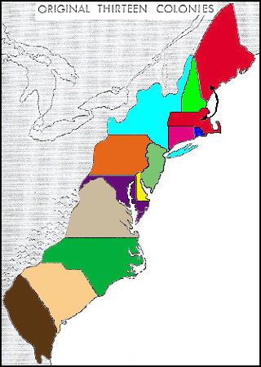
13 Colonies
By: Aubrey Culver

Slide 2
1. Virginia
Virginia was discovered in 1607 by the London Company . It became a royal colony in 1624.

Slide 3
Jamestown
In 1607 104 people came on three ships called the Susan Constant, Godspeed, and the Discovery to start a settlement. They started that settlement on the land of the James River in Virginia. They called the land Jamestown after King James the first. Jamestown was close to the Powhatan village

Slide 4
Important People
Captain John Smith
Pocahontas
Chief Powhatan
John Rolfe
Nathaniel Bacon

